Slide 1

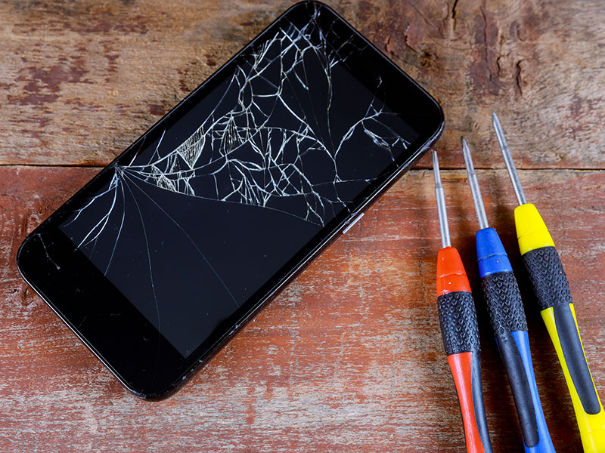
Fix-It
-Arthi Ravichandran
-Bhagyashree Parkar
-Dhananjay Gaonkar
-Parth Gandhi

Slide 2

How did we come up with Fix-It?
When a user checked his/her phone after it had been dropped, the phone's rear camera and display both sustained significant damage.
Apple and Best Buy quoted a rough estimation of $600 and $550 respectively.
Found a local technician to repair the same phone for $350 and with no quality changes.
Additionally reusing old electronics reduces e-waste and promotes sustainable living.

Slide 3
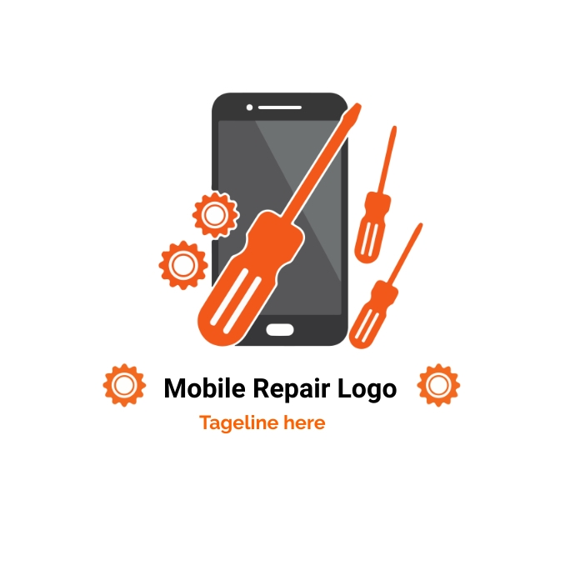
What is Fix-It?
Users can register, view, and search nearby local repair shops or individual people using the platform's app.
Our app motto is to help people find their ideal answer to their problem, hence the app will always be free in its earliest stages.
When the program achieves its user download database objective, the business will begin charging technicians a premium subscription to use the application's premium features.

Slide 4
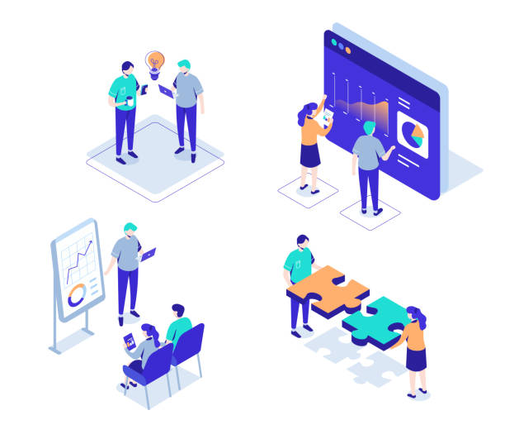
Business model:
Now, we will talk about the Business Model. There will be two primary stakeholders in the ecosystem. I.e.,
Users: Anyone looking to use the application's services to locate nearby businesses or individuals that can fix their electrical devices.
Repair Shops and Individual Employees: Based on prior performance and user feedback, they will be highlighted on the app.

Slide 5
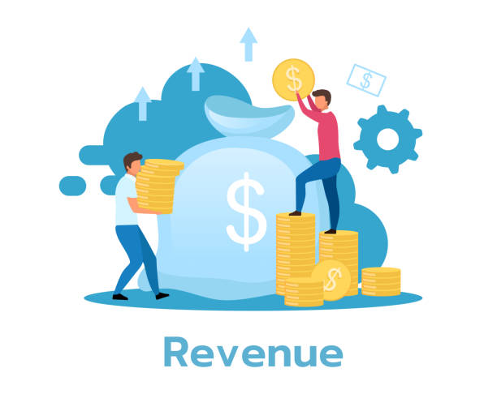
How will Fix-It generate Revenue?
The application will generate income through commissions from each order or sale. For each repair work done we will be charging the customer a small commission.
Advertising revenue will be our second revenue generation model where we can host various ads on our websites and or mobile application.
We will create a new premium subscription option for freelance technicians. Where the technicians can pay a subscription fee to get more work.

Slide 6
Expenses :
With the revenue Generated from the investments and funds initially we would want to set up an office virtually or offline for building a web application and mobile application.
Secondly, we will also want to increase our outreach to various technicians to get onboarded with us and discuss their salary expectations. With this data we can budget out a portion of the investments towards the technicians salaries.
As a part of RnD we would want to conduct a market research and understand our target audience and try to build a prototype model based on it . Once we have the required data we can focus on that region or states in the US markets. This will help us grow immensely and in a focused manner.
The profit generated from this can be reinvested in growing, advertising and marketing in regions where the data shows scarcity.

Slide 7
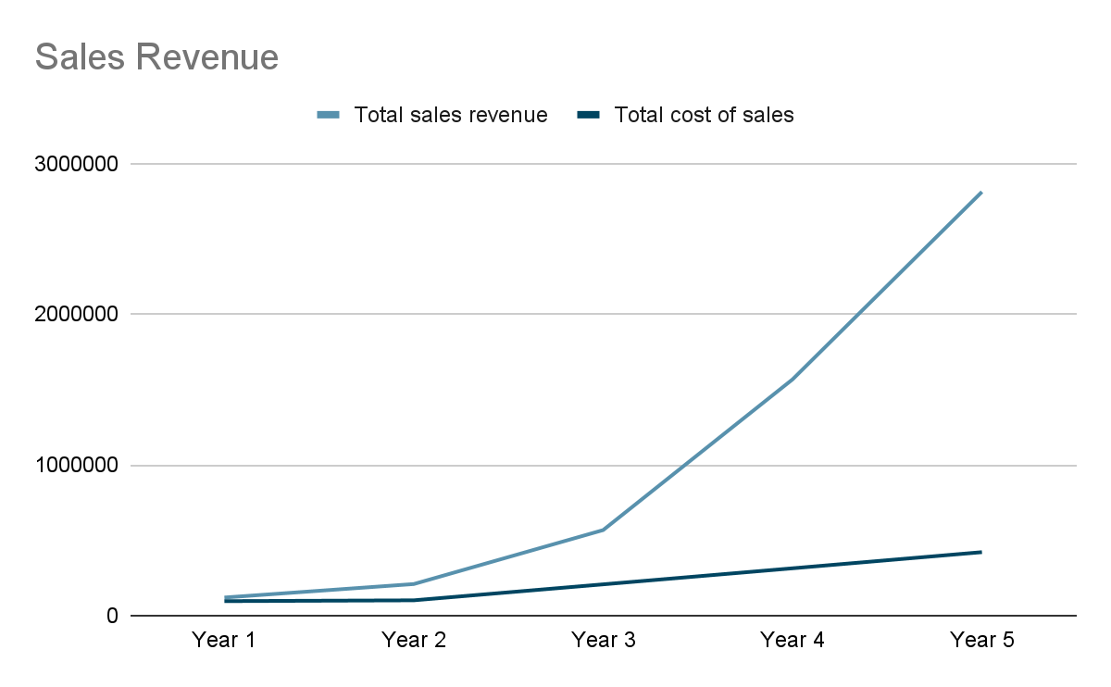
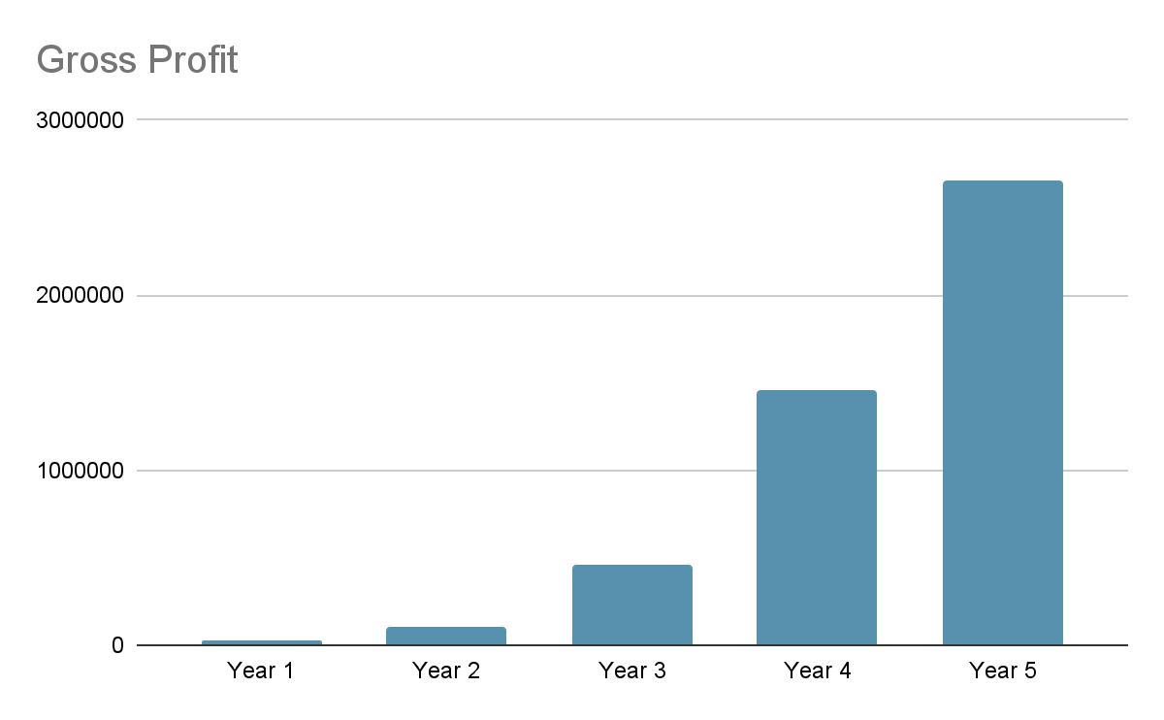
5 year income projection :

Slide 8
IT Strategy: Technology Setup and Structure
There will be mobile and web versions of the "Fix-It" application.
Before the technicians' accounts are approved on the app, background checks will be conducted on them (this will be implemented at the initial stage).
The business will use Amazon Web Services (AWS), an Amazon-operated cloud-based database service with pay-as-you-go billing, to host the platform.
Amazon offers a wide range of services, and in this case, it will be in charge of the following:
Amazon management console
The technology platform, Amazon EC2 (Elastic Compute Cloud) , Mobile App.
We will also provide a 24/7 help desk/ in app-technician through a chatbot on the app, which will give every kind of help required by the user.

Slide 9
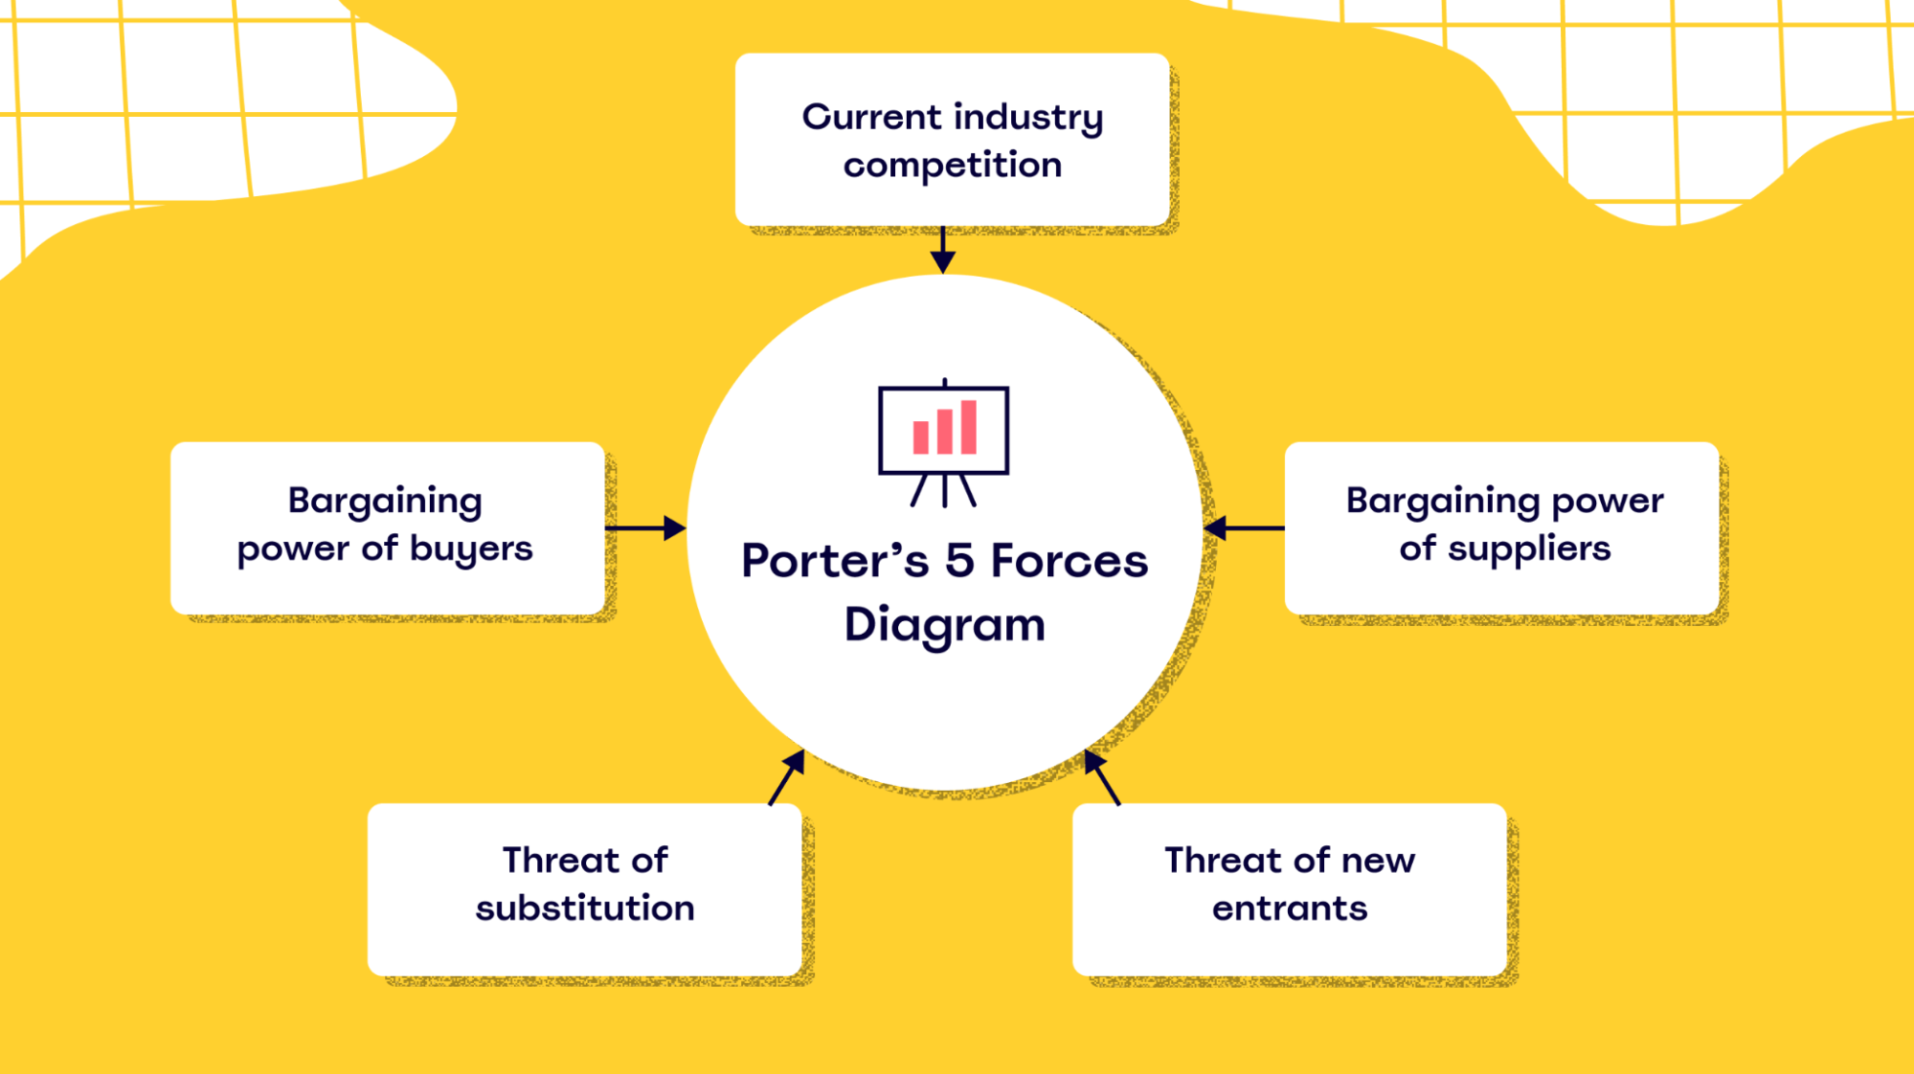
Porter's Five Forces
Porter’s Five Forces is a model that allows you to assess the intensity of a specific industry or commercial center.
It likewise thinks about your providers, end clients, and contiguous items that might represent a threat to your industry.

Slide 10


Competition in the industry:
Unique idea
Our product will focus mainly on:
upgrading the user-friendly environment
client criticism methods
Quality of the service offered
Potential of new entrants into the industry:
Other companies can find a potential market
come up with their own application and website
we must develop a robust system
With this robust system, the search will be faster and less time-consuming for our customers

Slide 11
5. Threat of substitute products:
Difficult to implement
Face the threat of new entrants into the industry
How to deal:
Upgrading and improving the idea depending on the feedback provided by the customers
Preparing future goals to sustain in the industry
Gaining the customers' trust
3. Power of suppliers:
Technicians are the main suppliers
Compatibility from various technicians and their work rates
For the supplier to get their skills and work popularized in the market and gain greater profits and growth
4. Power of customers:
Customers who negotiate vs. customers that won’t
Status of the Customers
Customers would not usually arrange for the repairing of a damaged item but look for more outstanding quality by buying a new product instead

Slide 12
7 Barriers to Entry
Replacement parts required for restoration will be hand-picked by technicians for a low price without affecting the quality.
Demand-side benefits of scale, known as network effects, occur whenever customers are likely to choose a company’s product as that company’s customer base gets more prominent.
A one-time new member discount will lure customers into looking at what we offer as it will automatically reduce the time, psychological and effort-based costs.
We intend to overcome capital requirements by starting small and growing organically from profit rather than seeking large loans.
To be ahead of the competition and thrive in an ever-changing market, we need to explore unique ways to engage existing users while attracting new ones.
We plan to develop our application as secure, reliable, and user-friendly for a successful sustainable advantage to distribution channels.
We must adhere to government rules and regulations, such as licensing, when we would have put the app on the market before.

Slide 13
Thank You!

